Slide 1
CSCE 1035 Computer Programming I Chapter 10 Exceptions
University of North Texas

Slide 2

10.1 Handling Exceptions Using Try and Except

Slide 3

Exceptions
Errors caused by not following the proper structure (i.e., syntax) of the language is called syntax error or parsing error
Errors that occur at runtime are called exceptions
An exception is an event that disrupts the normal flow of the program’s instructions
In general, when Python encounters a situation that it cannot cope with, it raises an exception, which is a Python object that represents an error
When an exception is raised, it must either handle the exception immediately or it would otherwise terminate the program with details about why the error occurred
Examples of these runtime errors include trying to open a file and does not exist (FileNotFoundError) or trying to divide a number by zero (ZeroDivisionError)

Slide 4
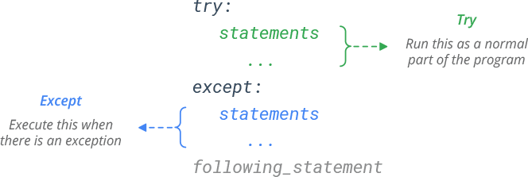
Exception Handling
If you suspect you have code that may raise an exception, you can defend your program by placing the suspicious code in a try block
If that exception occurs, the code in the try block stops being executed and code in the except block is executed
An except block is a block of code that handles the problem as elegantly as possible
If no error occurs, the code in the except block does not execute

Slide 5
Unhandled Exceptions
There are two ways for an exception to go unhandled
There is no except block specifying the exception of the right type
The exception was raised outside of the try suite
In both cases, an exception will cause the program to halt
An error message provides a traceback with information regarding line numbers that caused the exception
It indicates the type of exception and a brief description of the error that caused the exception to be raised

Slide 6
10.2 Multiple Exception Handlers

Slide 7
Multiple Exception Handlers
A single try block can have multiple except blocks
This is useful when a try block contains statements that may throw different types of exceptions
Should write an except block for each type of exception that needs to be handled
If no exception handler exists for an error type, then an unhandled exception may occur, which causes the interpreter to print the exception and halt the program
An except block that does not list a specific exception will handle any exception that is raised in the try block
This should always be the last in a series of except blocks
Multiple exceptions can be put into a single except block using parentheses to have except block handle all of them

Slide 8
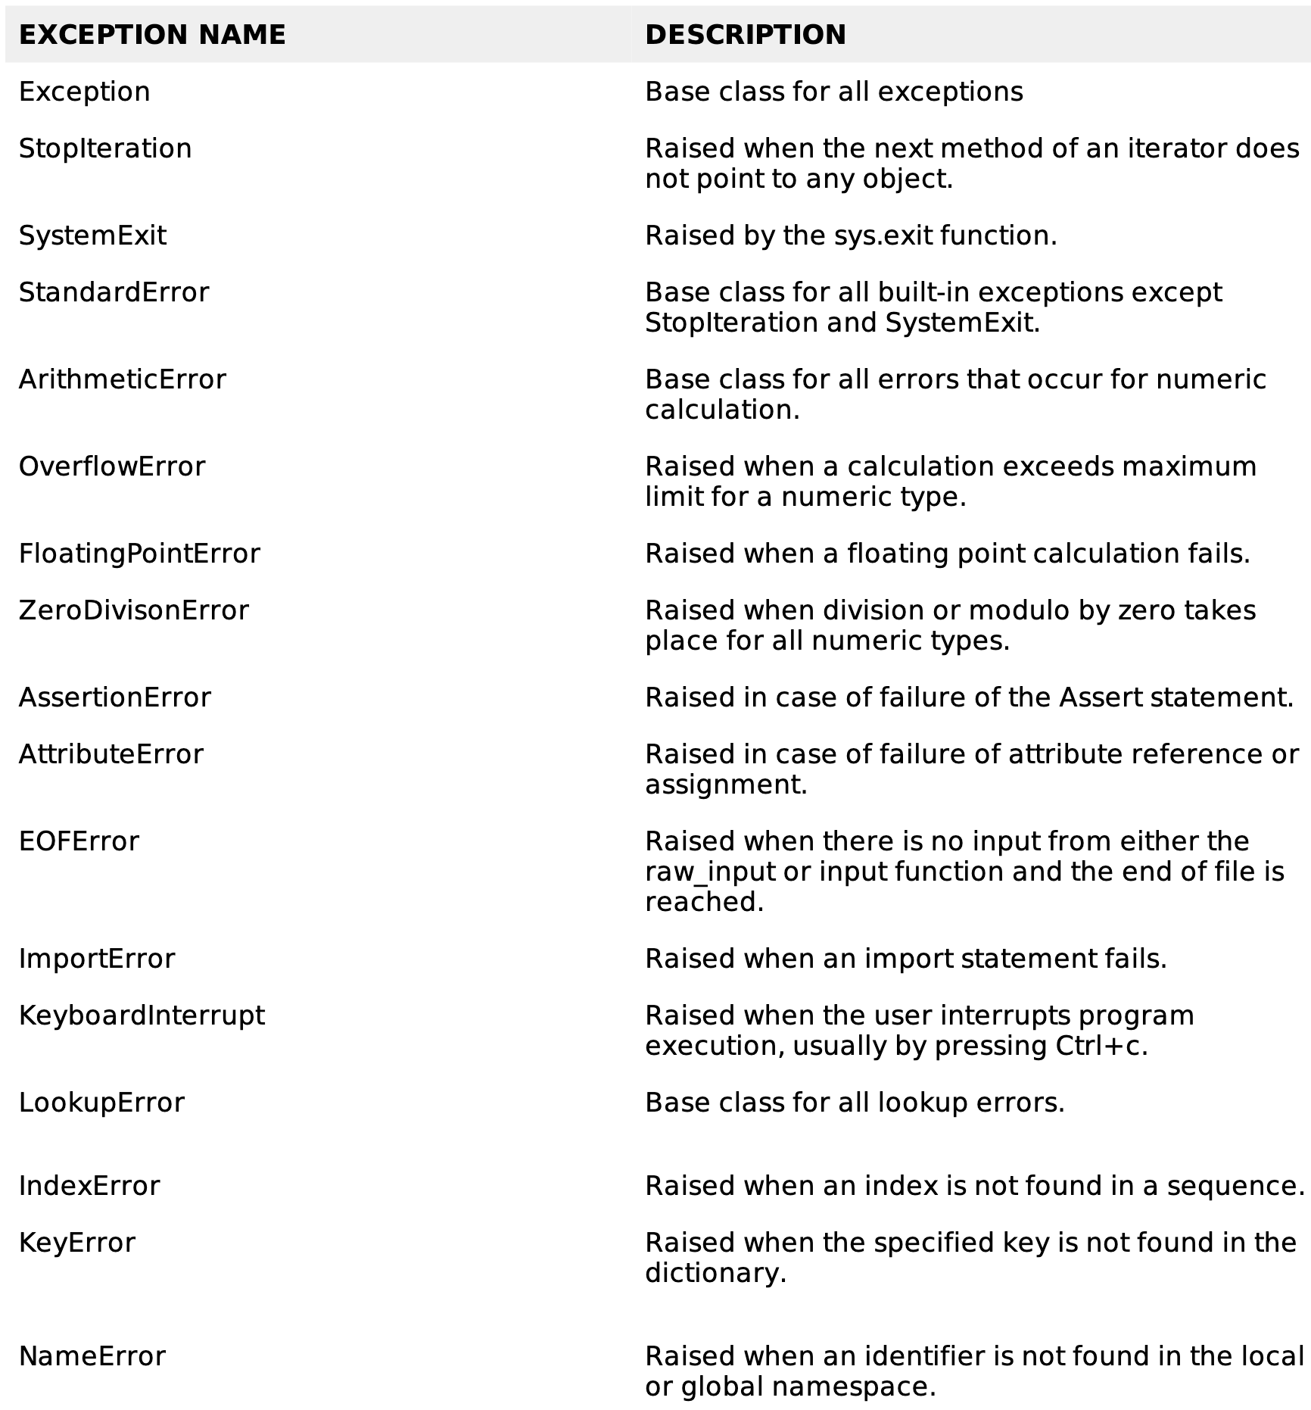
Some Standard Exceptions
https://docs.python.org/3/library/exceptions.html

Slide 9
10.3 Raising Exceptions

Slide 10
Raising Exceptions
How is an exception created?
An exception is raised from a function
When a function detects an error, it can create an object of an appropriate exception class and raise the object
The raise statement allows the programmer to force a specified exception to occur
raise ExceptionClass('Error details')
An exception object is created in memory when an exception is thrown
We can assign the exception object to a variable in the except clause
except ValueError as err:
Then we can pass the exception object variable to the print() function to display the error message

Slide 11
10.4 Exceptions with Functions

Slide 12
Exceptions with Functions
Exception handlers don’t just handle exceptions if they occur immediately in the try block
They can also handle exceptions if they occur inside functions that are called (even indirectly) in the try block
>>> def this_fails():
... x = 1/0
...
>>> try:
... this_fails()
... except ZeroDivisionError as err:
... print('Handling runtime error:', err)
...
Handling runtime error: division by zero

Slide 13
10.5 Using Finally to Cleanup

Slide 14
The else and finally Blocks
After the except block(s), you can include an else block
This is a block of statements that are executed if the code in the try block does not raise an exception
If an exception was raised, the else block is skipped
To ensure some code runs no matter what errors occur, you can use a finally block
The finally block is placed at the bottom of the try suite
The purpose of the finally block is to perform cleanup before exiting
Code within the finally block always runs after execution of the code in the try, and possibly in the except blocks
You may want to exit the system as a result of an exception
import sys
sys.exit([arg])
The optional argument is an error number to report, where 0 is usually regarded as success

Slide 15
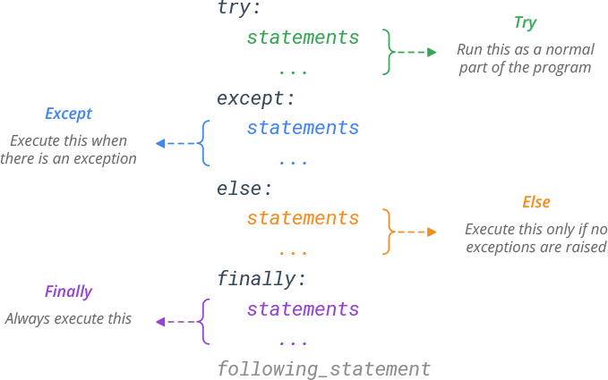
Try-Except-Else-Finally Syntax

Slide 16
Finally Block Scenarios
No exception
Execution continues in the finally clause, and then proceeds with the rest of the program
Handled exception
Exception handler executes and then the finally clause
Unhandled exception
The finally clause executes and then the exception is re-raised
try block exit
The finally clause executes if any break, continue, or return statement causes the try block to be exited

Slide 17
10.6 Custom Exception Types

Slide 18
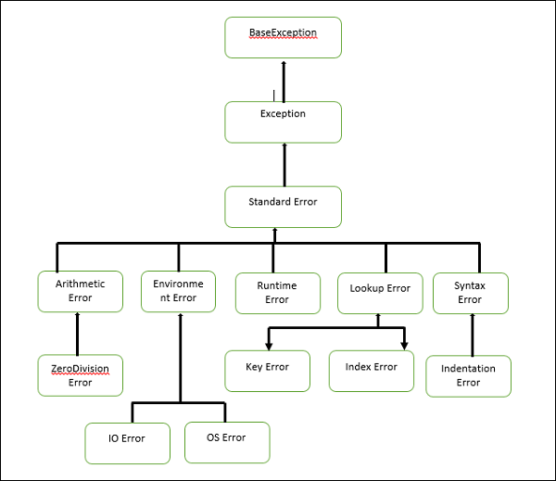
User-Defined Exceptions
Python allows you to create your own exceptions by deriving classes from the standard built-in exceptions

